Slide 1
Capstone Project IBM HR Attrition Prediction
Submitted by :-
Viki P. Yeole
Batch:-
PGA 9 Batch

Slide 2
Content
Introduction of HR analytics.
Importing the Dataset
Cleaning the Data
Upsampling Of Target Column
Visualistion
Conclusion
Correlation Matrix
Modeling of Algorithms
Final Predictions of Algorithms

Slide 3
Introduction of HR Analytics
What is HR analytics ? :-
Collecting and Analyzing Human Resource (HR) data,
Improve an organization’s workforce performance.
Tells HR for employee satisfaction to co-ordinate, give better performance and employee will not leave the company.

Slide 4
About Dataset
We have 1470 rows and 35 columns in the IBM hr attrition dataset.
It has have numeric and object columns in Dataset.
Here we have predicted the Attrition of employees by Yes or No.

Slide 5
Process Design
The process is done by Supervised Machine Learning Algorithm
The behind this is we have prior knowledge on our output values.
We have also visualised the dataset by factors affecting on attrition rate.
Hence by this we have found the conclusion of this.

Slide 6
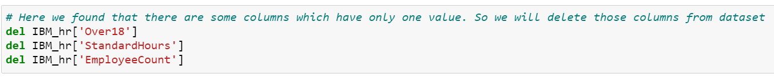
Exploratory Data Analysis
Data cleaning:-
As It is collected by HR department so There is no Null Values in this dataset.
There are some columns who have only 1 values in that. So we have delete those columns.
Analysing the data by cross tab using ratio of one variable with other.

Slide 7
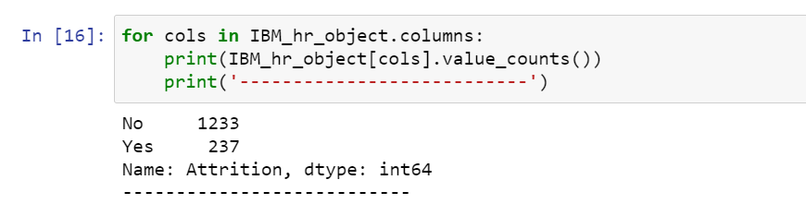
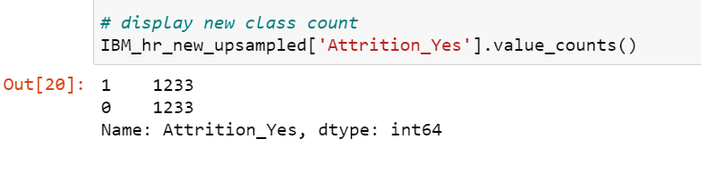
Exploratory Data Analysis
Splitting data by Data Type:-
We have split the data as data type object and numeric.
Checked count of values of categorical variables.
Converting to dummies and then concatenated.
Upsampled data as count of ‘yes’ in attrition is much less than ‘NO’
Before up sampling After up sampling

Slide 8
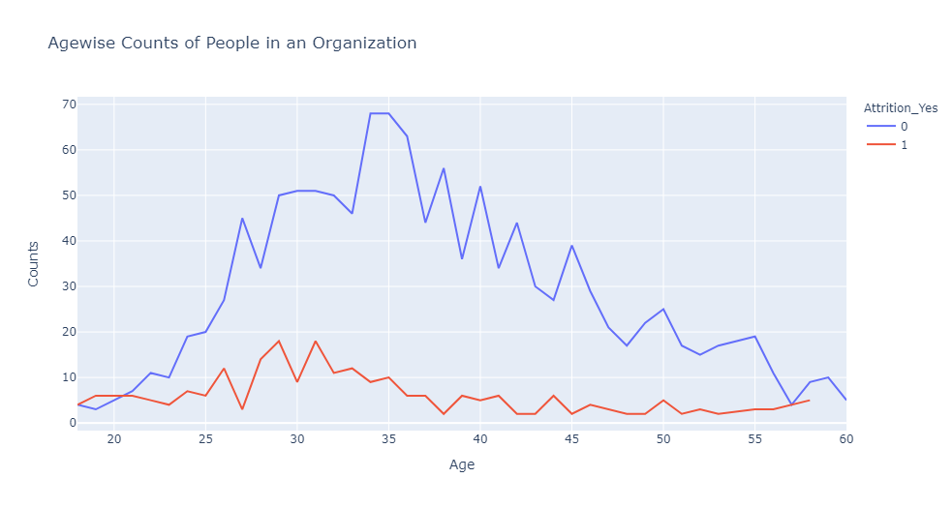
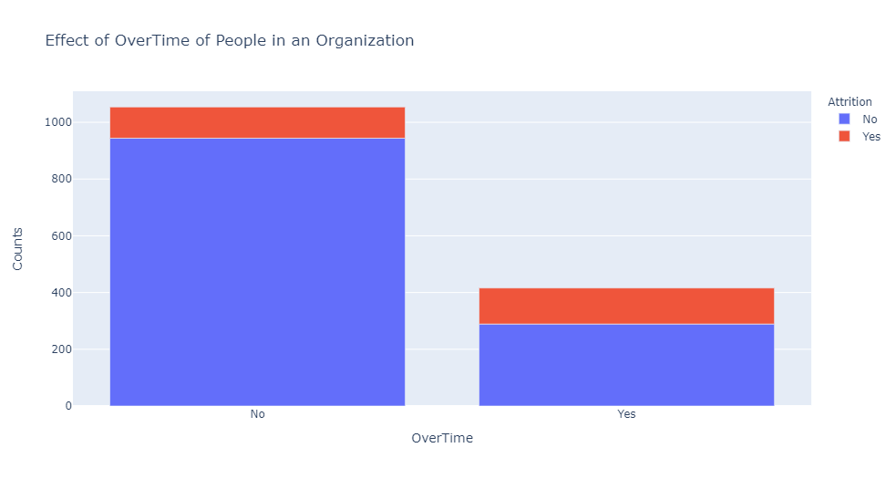
Visualisation

Slide 9
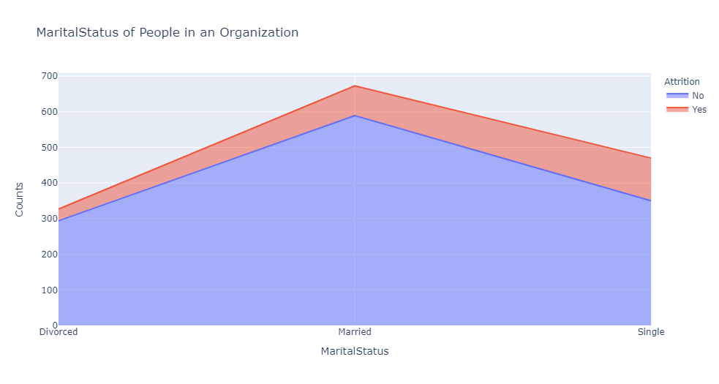
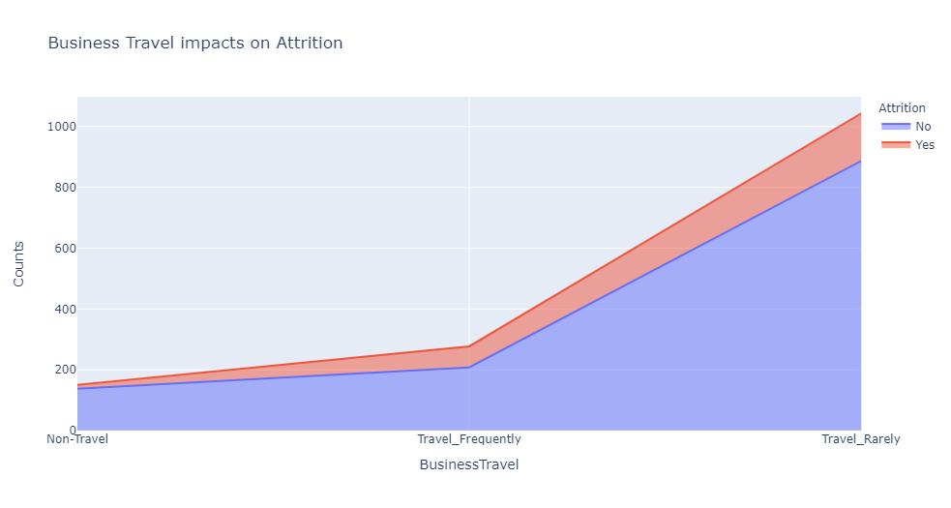
Visualisation

Slide 10
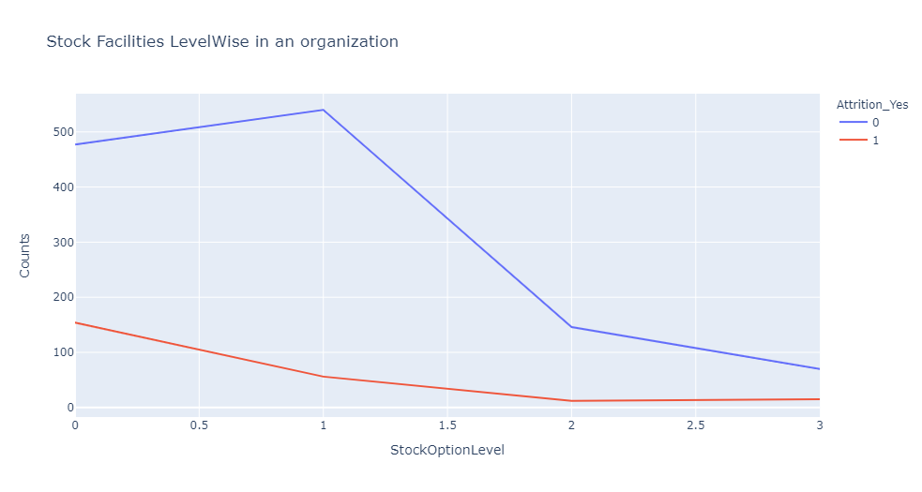
Visualisation

Slide 11
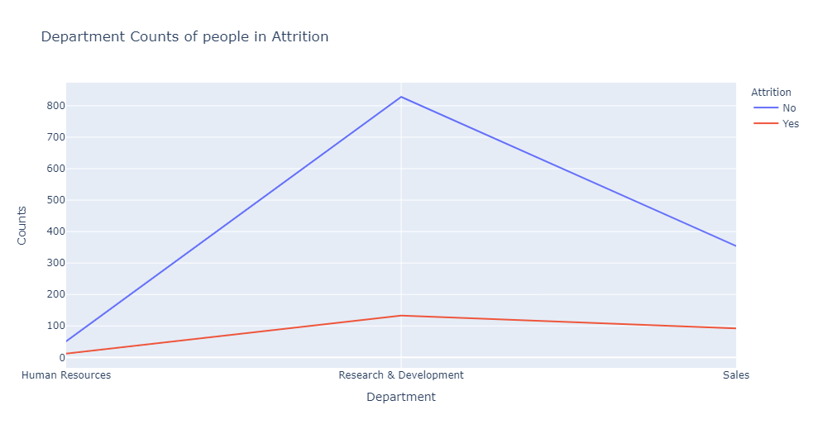
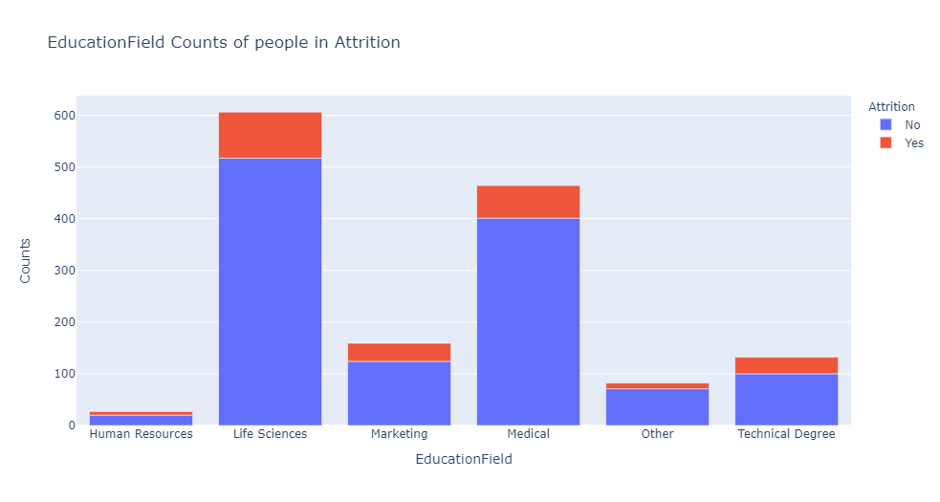
Visualisation

Slide 12
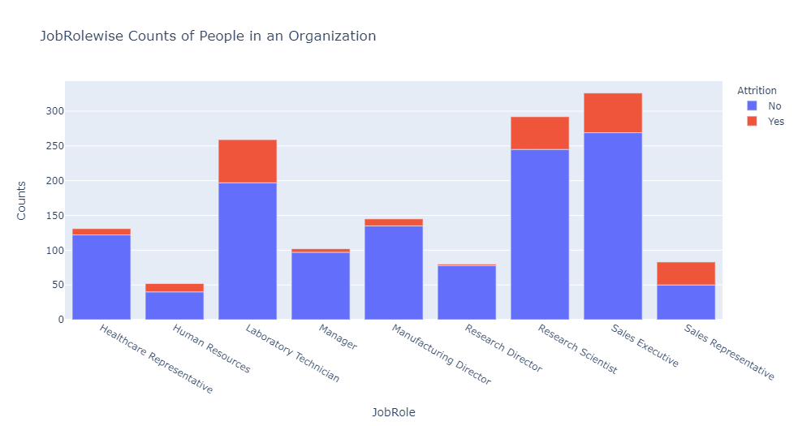
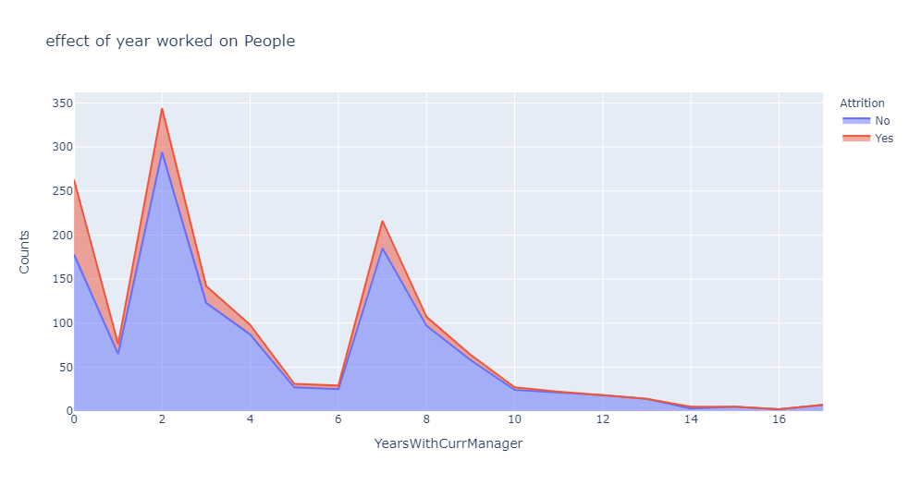
Visualisation

Slide 13
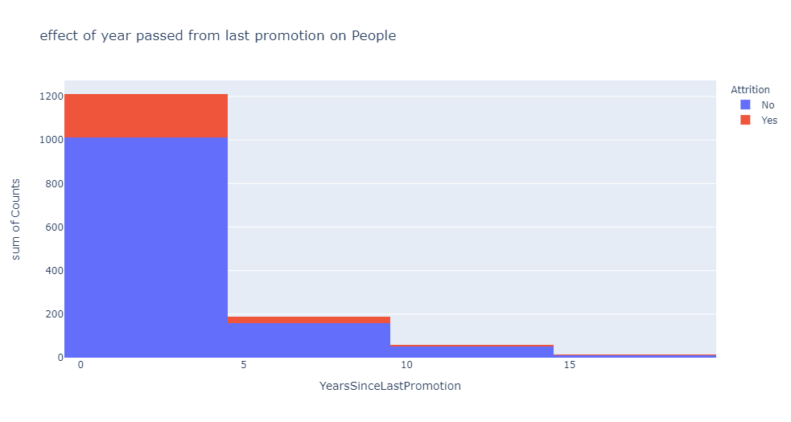
Visualisation

Slide 14
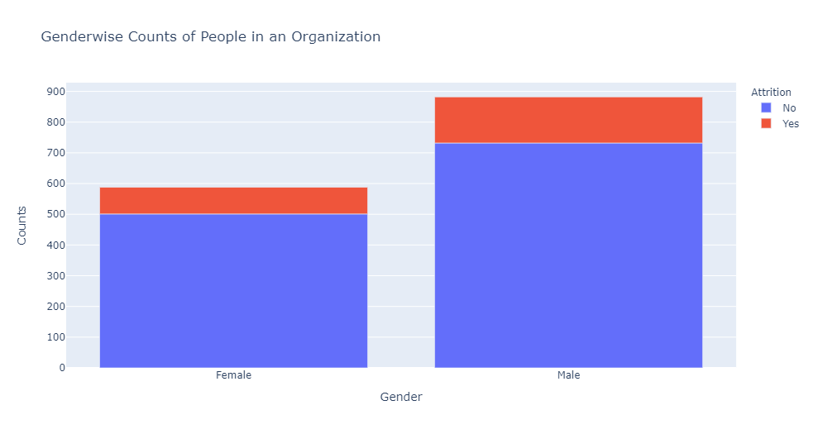
Visualisation

Slide 15
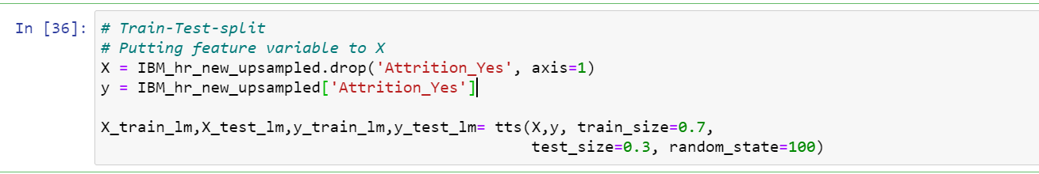
Splitting the Dataset in Train and Test
Data Partition:-
Splitted the data in 2 parts X and y where X contain all column of upsampled hr data except ‘Attrition_yes’ Column.
y contain only Attrition_yes column only.
Again we have partitioned data into ratio train size 0.7 and test size 0.3

Slide 16
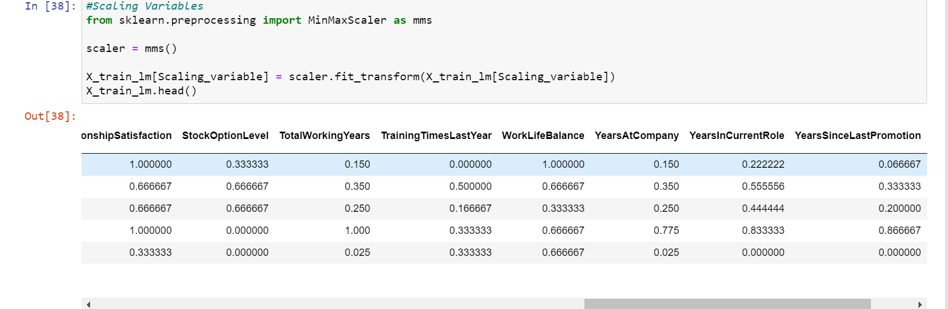
Scaling the entities
Here we have used Min-Max scaler where we have scaled variables between 0 to 1.

Slide 17
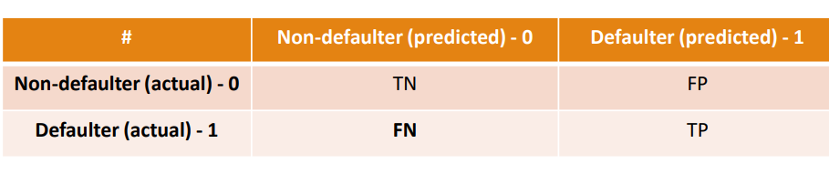
Evaluation Process
Accuracy: Accuracy determine how often the model predicts default and non-default correctly.
Precision: Precision calculates whenever our models predicts it is default how often it is correct.
Recall: Recall regulate the actual default that the model is actually predict
True Positive – A person who is defaulter and predicted as defaulter.
True Negative – A person who is non-defaulter and predicted as non-defaulter.
False Positive – A person who is predicted defaulter is non-defaulter.
False Negative – A person who is predicted non-defaulter is defaulter.

Slide 18
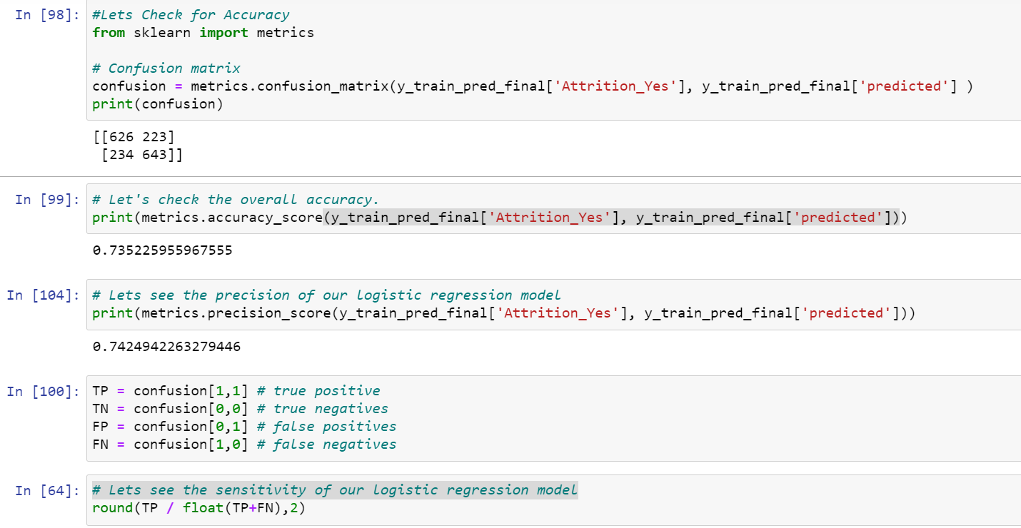
Logistic Regression
Here first we have Run the model with Recursive feature elimination as we have to use only those variable which are Important for predicting the attrition.
Running model with stats model and generalized linear model for predicting coefficient .
Using vif we have removed multicollinearity.
Again fit the model with logreg and then predicted confusion matrix and classification report

Slide 19
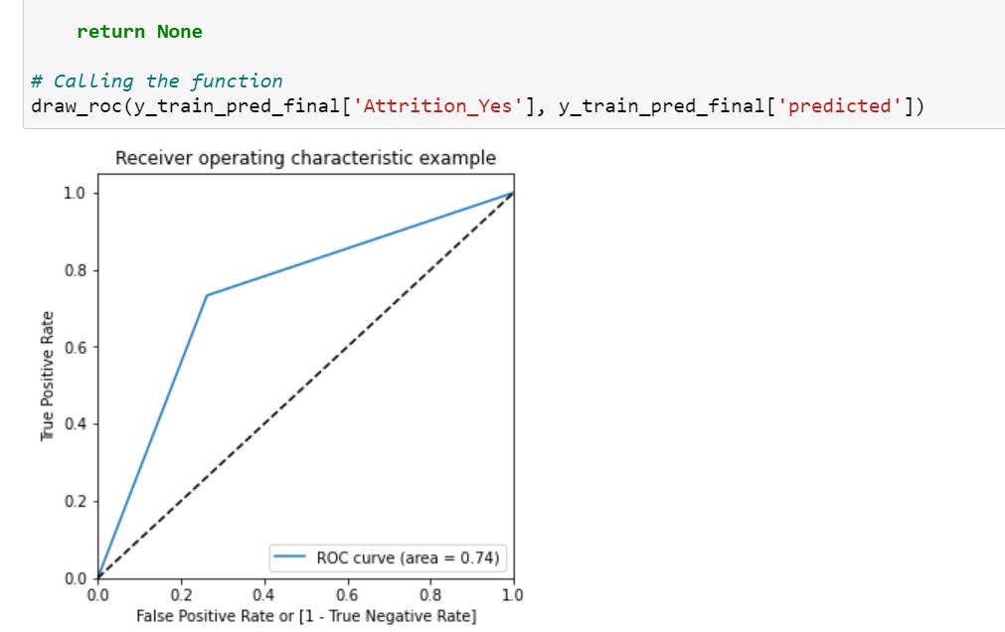
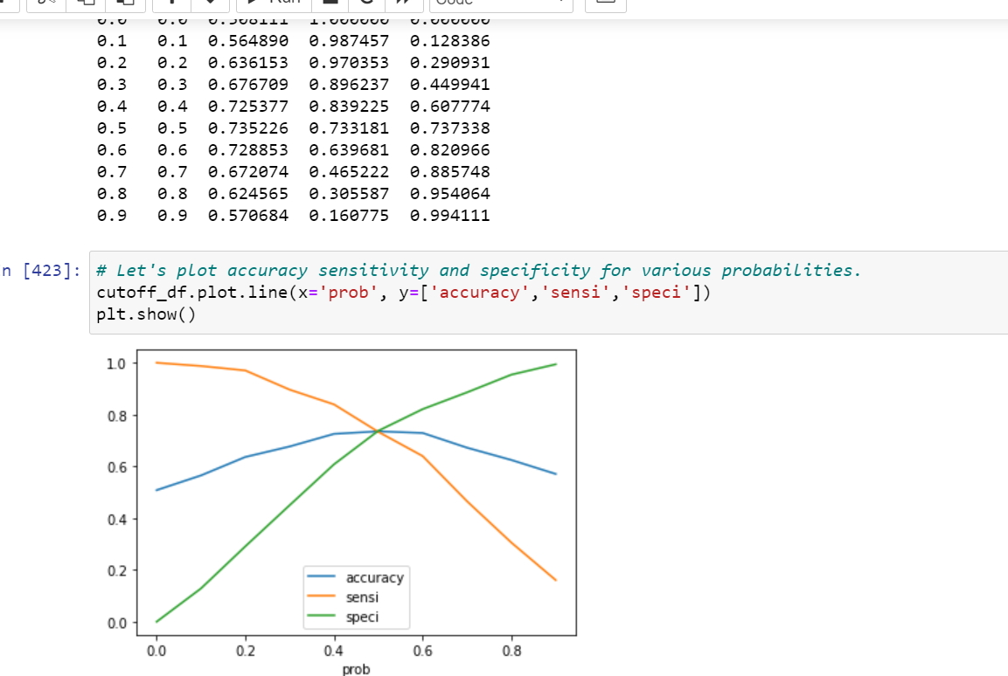
ROC curve

Slide 20
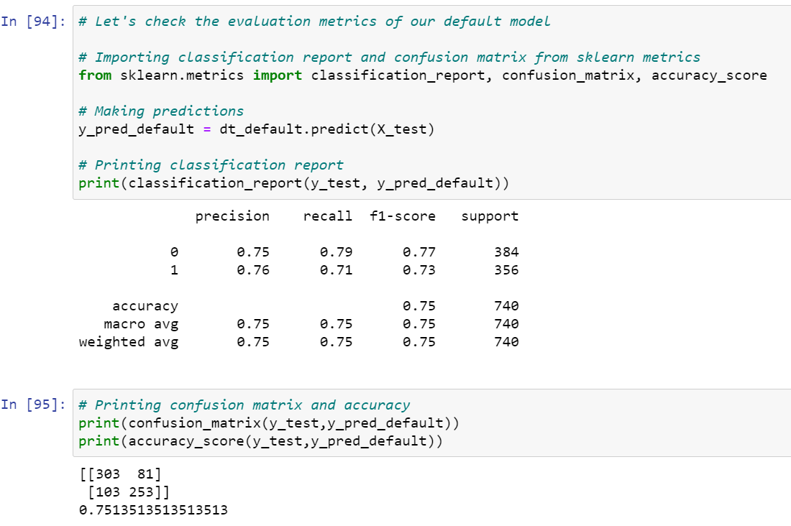
Decision Tree

Slide 21
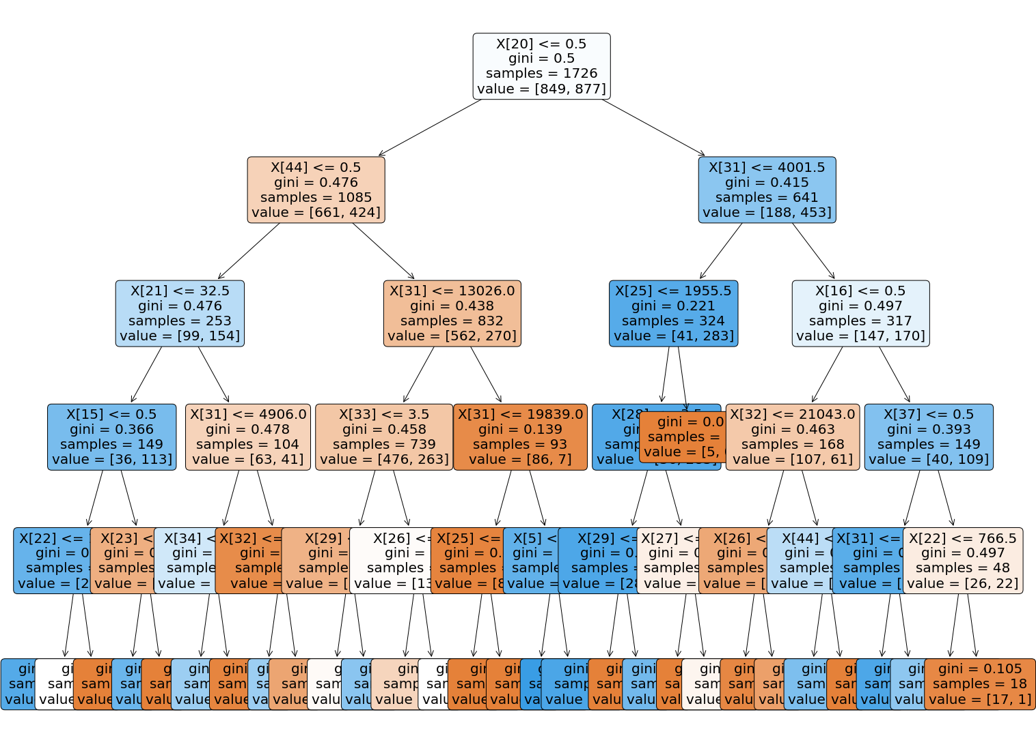
Decision Tree
Fitted model and found the confusion matrix
Plotted tree by importing tree from scikit library
Cross validated by max depth min samples leaf and min split
Fitted model at best estimator and found the accuracy which 0.7729

Slide 22
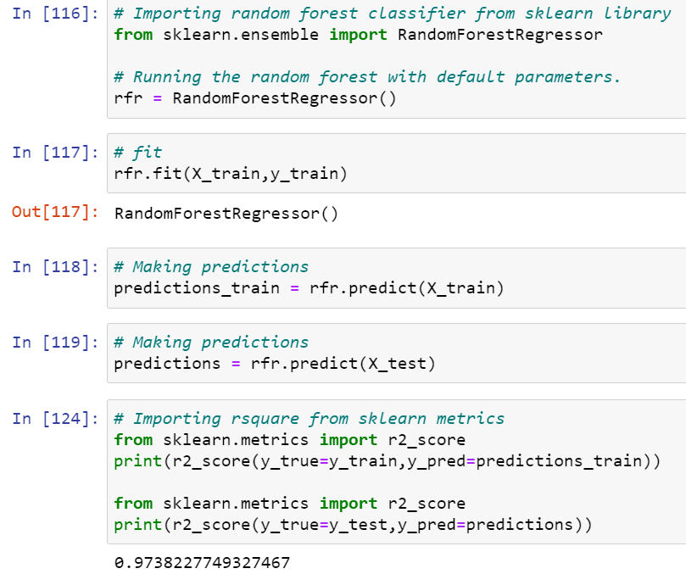
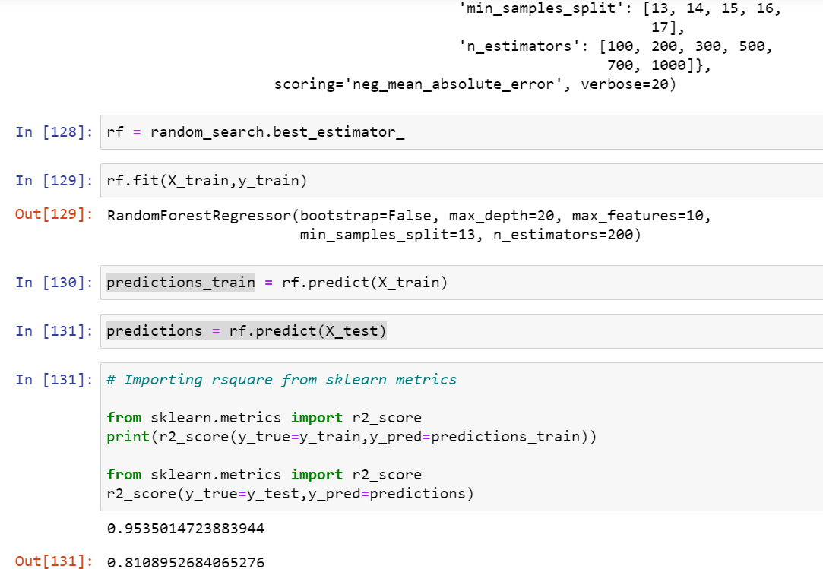
Random forest
Before best estimation
After finding best estimator

Slide 23
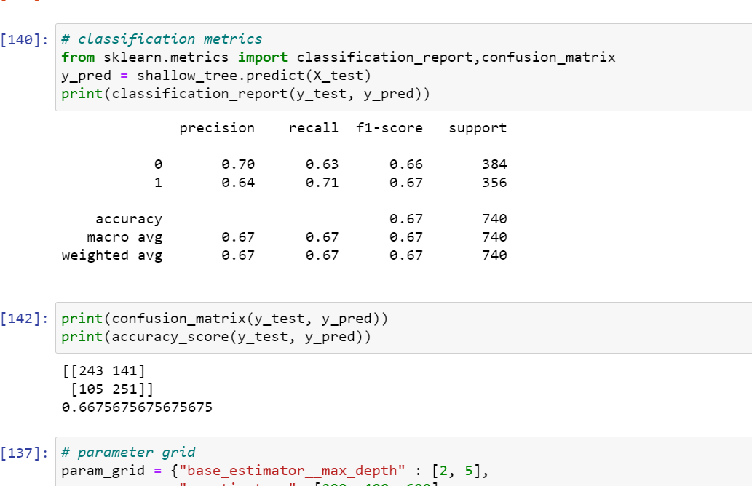
Ensemble Technique

Slide 24
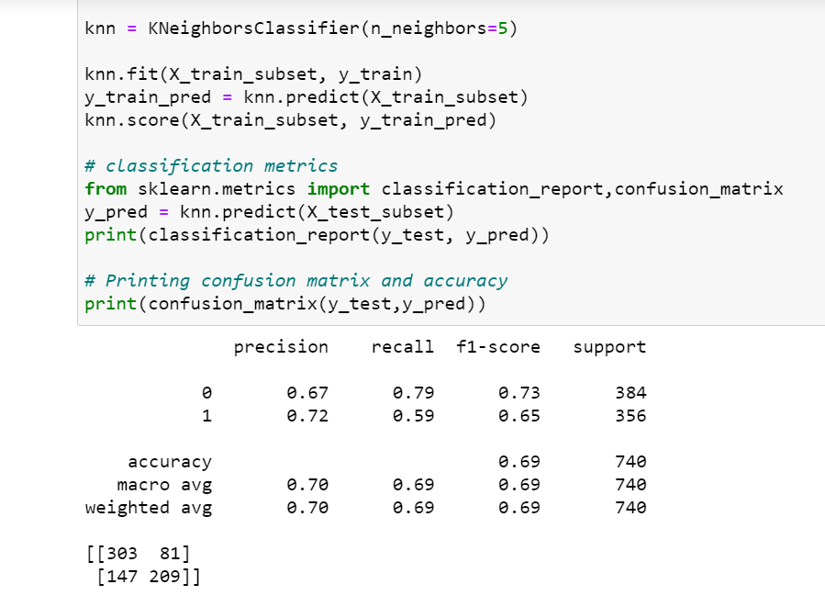
K- nearest neighbor

